Slide 1


Tech Nerds
Hazel – A Virtual Assistant

Slide 2
Introduction
The purpose of Hazel virtual assistant is to provide a program that understands natural language voice commands and completes tasks for the user.
Such tasks generally performed by a personal assistant include reading text or email, playing music, opening calculator, opening different applications and providing a user experience.
Hazel is a virtual assistant that listen and respond to verbal commands.
Voice assistants are apps that use voice recognition technology, natural language processing and AI to respond to humans.
Using this the device synthesizes the users message, breaks it down, evaluates it and offers a meaningful response in return.

Slide 3
Problem Definition (Reason why you chose this Problem Statement)
In the Recent Times, Android has developed Google Assistant and IOS has come up with Siri but all these Assistants are developed for Mobile Phone but Laptops don’t have any Virtual Assistant so we have come up with an idea of HAZEL : A Virtual Assistant this is specifically for laptops.
We have opted to proceed with this project due to the fact that Virtual assistants are becoming increasingly popular in today's fast-paced world, as they offer an efficient and cost-effective solution to managing daily tasks and responsibilities.
The primary goal of developing Hazel is to target the 33% who rely on laptops and desktops for internet usage and improve automation processes as well as the new coming generation of users.
Hazel will enable users to easily give commands and carry out tasks with greater efficiency, while also reducing the amount of human effort required.

Slide 4
Existing System (Optional)
The overall system basically consist of manually typing and all the data has to be provided manually by typing resulting in
Human effort
Error Messages
Time consumption
Information overload
Some of the Existing systems are:
Siri on Apple devices
Cortana on Microsoft Devices
Google Assistant on Android devices.

Slide 5
Proposed Solution
The work started with analyzing the audio commands given by the user through the microphone.
When you give a command to your virtual assistant the Automatic Speech Recognition enables the device and translates it from speech to text.
After that it comes to Text interpretation where the machine can identify the intent behind what the user has said the meaningful words as well as context.
After this the machine can search for a valid answer and respond accordingly.

Slide 6
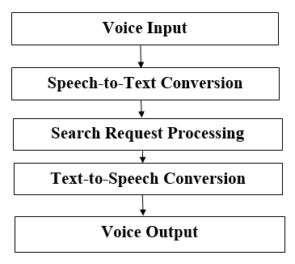
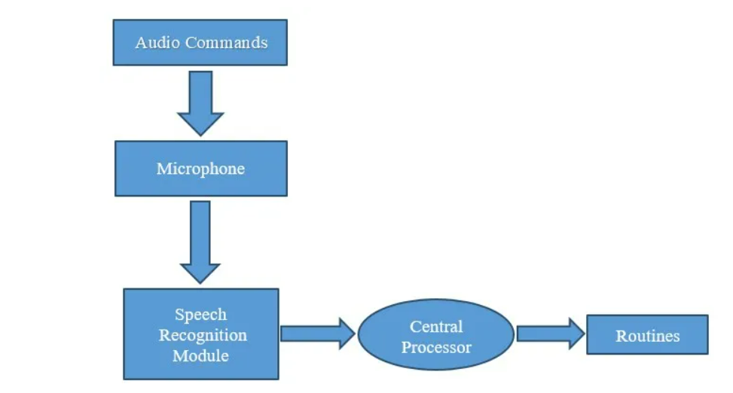
Architecture / Flow Chart

Slide 7
Hardware and Software Technology Used
HARDWARE REQUIREMENTS
Processor: i3 or higher version
RAM: 4 GB (Minimum)
Hard Disk: 20 GB
SOFTWARE REQUIREMENTS
Python
PyCharm / Visual Studio Code

Slide 8
Future Scope
In the future we have decided to take hazel on a larger scale and making it software for PCs and Desktop so that everyone will be able to take the benefits of the automated process that it is being providing.
The aim is to make it a platform independent program supported by multiple OS platforms.
One of the future work is adding corpus (i.e. large database) in order to carry query and answer to the query increasing the efficiency, accuracy as well as speed of Hazel.
We are being working in a such way that Hazel can be used in sectors like Smart Homes, IOT, etc

Slide 9
Thank You

